Slide 1

World Happiness
Ariel Fitzgerald
Kayla Fennell
Kela Njike Tah
Soumya Kinger
Renae Troy

Slide 2
Idea Submission
Analysis : Project Description: Analyze the global happiness of countries and see how various factors such as social, cultural, urban and environmental factors effect the happiness quotient.
Team Members: Ariel Fitzgerald, Renae Troy, Kela Njike Tah, Soumya Kinger, Kayla Fennel
Research Datasets: www.Kaggle.com
Research questions to answer:
What are the top three factors that effect the happiness index the most.
Which countries rank consistently high or low on the happiness index.
How environmental quality affects happiness index

Slide 3
Data Sources and Pre-Clean Up
Kaggle : World Happiness Report
The happiness scores and rankings use data from the Gallup World Poll. The scores are based on answers to the main life evaluation question asked in the poll. This question, known as the Cantril ladder, asks respondents to think of a ladder with the best possible life for them being a 10 and the worst possible life being a 0 and to rate their own current lives on that scale. The scores are from nationally representative samples for the years 2013-2016 and use the Gallup weights to make the estimates representative.
EM-DAT: The International Disaster Database
Systematic collection and analysis of these data provides invaluable information to governments and agencies in charge of relief and recovery activities.
Natural Disasters included biological, climatological, geophysical, hydrological, and meteorological events.
United Nations Population Division. World Urbanization Prospects: 2018 Revision.
https://data.worldbank.org/indicator/SP.URB.TOTL.IN.ZS
Data Limitations:
Each year of data not having matching columns initially(merge limitations).
Each database download have more or less columns when compared to another year.(filtering through what columns were needed)
EM-Dat data was all downloaded into one big file with all 4 years combined into one csv file
Time: Having to filter through the data to determine the best way to interpret the data with the information available which meant some data could not be used.
EM-Dat data was all downloaded into one big file with all 4 years combined into one csv file
How the urban population is defined in each country
Total population may not be measured accurately
Notes:
Merging –
WHR: Each year of data was individually downloaded and all column headers did not match. Also had to consider how to accurately name each column for each year according to how we wanted to merge it.
EM-DAT: Database downloaded with all 4 years included in 1 file.
Cleaning:
Used excel for the initial cleaning of the data to make all column names match for each year and adding the year to each column title in order to avoid issues during the initial overall merge of data
Determining to keep or remove null items or any countries that may not be listed not only in each year or happiness data but also during each year for the natural disaster data
Decided to keep null cells
Decided to replace null results for the natural disaster’s data after discovering on the database site that if missing, than the country had no data to show which was the reason for the nulls in some years and data present in others.

Slide 4
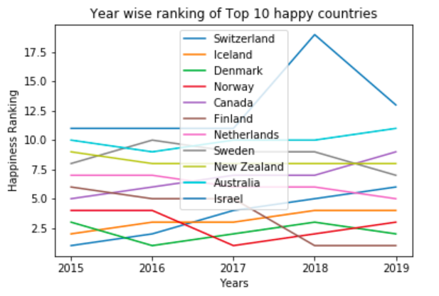
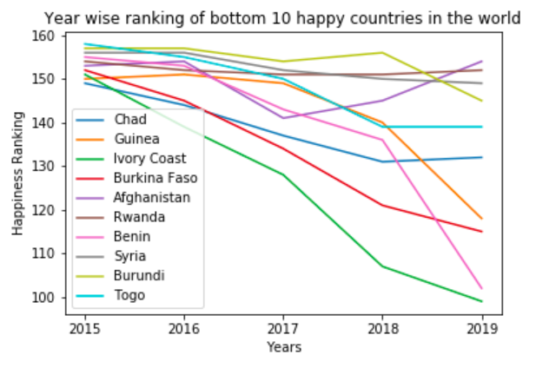
Year to year trends in Happiness Score
The top 10 happy countries have maintained their position in top 10 with little fluctuation year on year, except Israel, which showed a major upward shift in 2018.
There has been a lot of fluctuations in bottom 10 countries.
Further analysis of countries was done on 4 parameters – GDP, Health, Generosity and Freedom
Notes:
happiness_metadata = pd.merge(data_2015,data_2016, on = "Country")
happiness_metadata =happiness_metadata.rename(columns = {"Region_x" : "Region_2015",
"Happiness Rank_x" : "Rank_2015",
"Happiness Score_x":"Score_2015",
"Economy (GDP per Capita)_x" : "GDP_2015",
"Family_x":"Family_2015",
"Health (Life Expectancy)_x":"Health_2015",
"Freedom_x" : "Freedom_2015",
"Trust (Government Corruption)_x":"Corruption_2015",
"Generosity_x" : "Generosity_2015",
"Dystopia Residual_x":"Dystopia Residual_2015",
"Region_y" : "Region_2016",
"Happiness Rank_y" : "Rank_2016",
"Happiness Score_y":"Score_2016",
"Economy (GDP per Capita)_y" : "GDP_2016",
"Family_y":"Family_2016",
"Health (Life Expectancy)_y":"Health_2016",
"Freedom_y" : "Freedom_2016",
"Trust (Government Corruption)_y":"Corruption_2016",
"Generosity_y" : "Generosity_2016",
"Dystopia Residual_y":"Dystopia Residual_2016"})
happiness_metadata = pd.merge(happiness_metadata,data_2017, on = "Country")
happiness_metadata = happiness_metadata.rename(columns= {"Happiness.Rank" : "Rank_2017",
"Happiness.Score":"Score_2017",
"Whisker.high":"Whisker High_2017",
"Whisker.low":"Whisker Low_2017",
"Economy..GDP.per.Capita." : "GDP_2017",
"Family" : "Family_2017",
"Health..Life.Expectancy.":"Health_2017",
"Freedom":"Freedom_2017",
"Generosity":"Generosity_2017",
"Trust..Government.Corruption.":"Corruption_2017",
"Dystopia.Residual":"Dystopia Residual_2017"})
data_2018 = data_2018.rename(columns={"Country or region":"Country"})
happiness_metadata = pd.merge(happiness_metadata,data_2018, on = "Country")
happiness_metadata = happiness_metadata.rename(columns= {"Overall rank" : "Rank_2018",
"Score":"Score_2018",
"GDP per capita" : "GDP_2018",
"Healthy life expectancy":"Health_2018",
"Freedom to make life choices":"Freedom_2018",
"Generosity":"Generosity_2018",
"Perceptions of corruption":"Corruption_2018",
"Social support":"Social support_2018"})
rank_df = happiness_metadata[["Country","Rank_2015","Rank_2016","Rank_2017","Rank_2018","Rank_2019"]]
rank_df = rank_df.rename(columns={"Rank_2015":"2015","Rank_2016":"2016","Rank_2017":"2017","Rank_2018":"2018","Rank_2019":"2019"})
rank_transposed = rank_df.T
rank_transposed

Slide 5
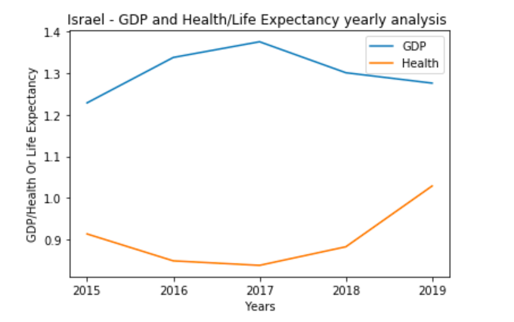
Deeper Analysis of Israel
Year on Year GDP analysis shows that it was highest in 2017, we can say that there might be a latency effect and higher GDP in 2017 resulted in higher Happiness Score in 2018. Further statistical analysis will be needed to confirm this.
Same can be said for Health also, it was lowest in 2017, but then had an increasing trend. But correlation doesn’t mean causation, so we can see that health and happiness score have a strong correlation, but that doesn’t mean good health causes high happiness score
Note: In last 5 years, Israel doubled its number of companies hitting the Unicorn mark to 20(Unicorn companies are those that have valuation of 1billion or more). Israel now has more unicorns than France, Germany and Australia combined. Only the US, UK and China have more.
Notes:
data_Israel_raw = happiness_metadata.loc[happiness_metadata["Country"] == "Israel",:]
data_Israel_2015 = data_Israel_raw[["Country","Rank_2015","GDP_2015","Health_2015","Generosity_2015","Freedom_2015"]]#,"Family_2015"]]
data_Israel_2015 = data_Israel_2015.rename(columns={"Rank_2015":"Rank","GDP_2015":"GDP","Health_2015":"Health","Generosity_2015":"Generosity","Freedom_2015":"Freedom"})
data_Israel_2016 = data_Israel_raw[["Country","Rank_2016","GDP_2016","Health_2016","Generosity_2016","Freedom_2016"]]#,"Family_2016"]]
data_Israel_2016 = data_Israel_2016.rename(columns={"Rank_2016":"Rank","GDP_2016":"GDP","Health_2016":"Health","Generosity_2016":"Generosity","Freedom_2016":"Freedom"})
data_Israel_2017 = data_Israel_raw[["Country","Rank_2017","GDP_2017","Health_2017","Generosity_2017","Freedom_2017"]]#,"Family_2017"]]
data_Israel_2017 = data_Israel_2017.rename(columns={"Rank_2017":"Rank","GDP_2017":"GDP","Health_2017":"Health","Generosity_2017":"Generosity","Freedom_2017":"Freedom"})
data_Israel_2018 = data_Israel_raw[["Country","Rank_2018","GDP_2018","Health_2018","Generosity_2018","Freedom_2018"]]#,"Family_2018"]]
data_Israel_2018 = data_Israel_2018.rename(columns={"Rank_2018":"Rank","GDP_2018":"GDP","Health_2018":"Health","Generosity_2018":"Generosity","Freedom_2018":"Freedom"})
data_Israel_2019 = data_Israel_raw[["Country","Rank_2019","GDP_2019","Health_2019","Generosity_2019","Freedom_2019"]]#,"Family_2019"]]
data_Israel_2019 = data_Israel_2019.rename(columns={"Rank_2019":"Rank","GDP_2019":"GDP","Health_2019":"Health","Generosity_2019":"Generosity","Freedom_2019":"Freedom"})
data_Israel = pd.concat([data_Israel_2015,data_Israel_2016,data_Israel_2017,data_Israel_2018,data_Israel_2019])
data_Israel
x_axis = ["2015","2016","2017","2018","2019"]
y_axis = data_Israel["GDP"].to_list()
y_axis_health = data_Israel["Health"].to_list()
plt.plot(x_axis,y_axis,label="GDP")
plt.plot(x_axis,y_axis_health,label="Health")
plt.legend(loc="best")
plt.title("Israel - GDP and Health/Life Expectancy yearly analysis ")
plt.xlabel("Years")
plt.ylabel("GDP/Health Or Life Expectancy")

Slide 6
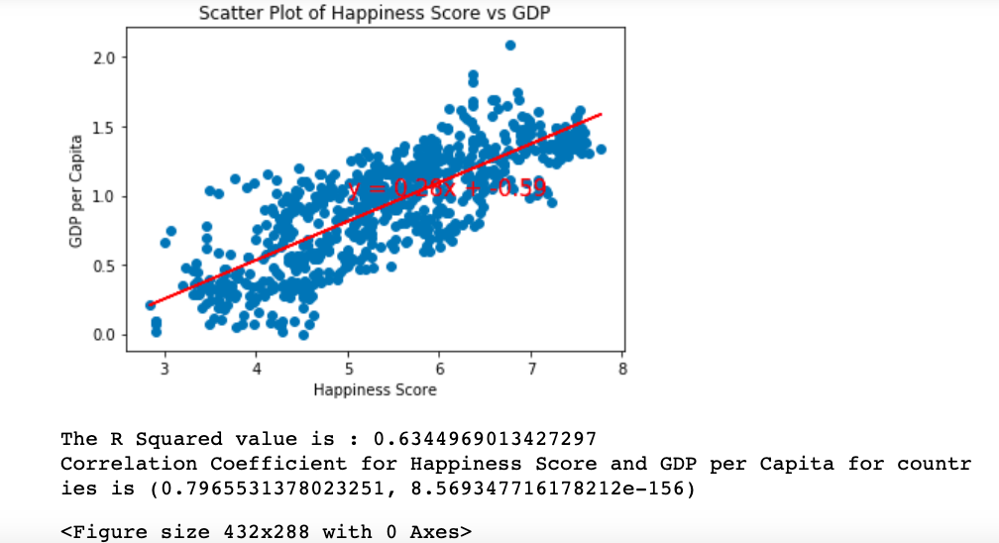
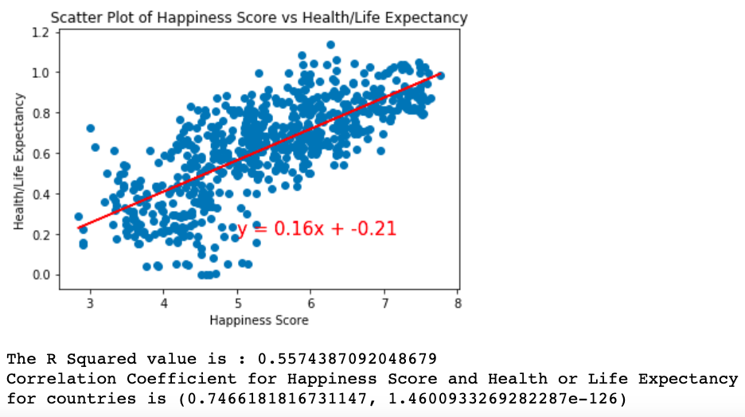
Regression Analysis between Happiness Score and GDP, Health/Life Expectancy
For both GDP and Health/Life Expectancy, the correlation coefficients are quite high (0.797 and 0.747 respectively). This shows that there is a strong positive correlation between happiness score and these factors.
Very low p-values (8.5693e-156, 1.460e-126) indicate that the correlation is statistically significant and different from zero. In other words, if we take a different sample from the same population, that sample will also show strong positive correlation between these variables.
Notes:
score_GDP_2015 = happiness_metadata[["Score_2015","GDP_2015"]]
score_GDP_2015 = score_GDP_2015.rename(columns={"Score_2015":"Score","GDP_2015":"GDP"})
score_GDP_2016 = happiness_metadata[["Score_2016","GDP_2016"]]
score_GDP_2016 = score_GDP_2016.rename(columns={"Score_2016":"Score","GDP_2016":"GDP"})
score_GDP_2017 = happiness_metadata[["Score_2017","GDP_2017"]]
score_GDP_2017 = score_GDP_2017.rename(columns={"Score_2017":"Score","GDP_2017":"GDP"})
score_GDP_2018 = happiness_metadata[["Score_2018","GDP_2018"]]
score_GDP_2018 = score_GDP_2018.rename(columns={"Score_2018":"Score","GDP_2018":"GDP"})
score_GDP_2019 = happiness_metadata[["Score_2019","GDP_2019"]]
score_GDP_2019 = score_GDP_2019.rename(columns={"Score_2019":"Score","GDP_2019":"GDP"})
score_GDP = pd.concat([score_GDP_2015,score_GDP_2016,score_GDP_2017,score_GDP_2018,score_GDP_2019])
score_GDP
#Scatterplot and linear regression between happiness score and GDP for all the years
x_scatter = score_GDP["Score"]
y_scatter = score_GDP["GDP"]
score = score_GDP["Score"]
gdp = score_GDP["GDP"]
(slope_gdp, intercept_gdp, rvalue_gdp, pvalue_gdp, stderr_gdp) = linregress(score, gdp)
regress_values_gdp = score * slope_gdp + intercept_gdp
line_eq_gdp = "y = " + str(round(slope_gdp,2)) + "x + " + str(round(intercept_gdp,2))
plt2.scatter(x_scatter,y_scatter)
plt2.xlabel("Happiness Score")
plt2.ylabel("GDP per Capita")
plt2.title("Scatter Plot of Happiness Score vs GDP")
plt2.plot(score,regress_values_gdp,"r-")
plt2.annotate(line_eq_gdp,(5,1.0),fontsize=15,color="red")
plt2.show()
print("The R Squared value is : "+ str(rvalue_gdp ** 2))
r_gdp = st.pearsonr(score,gdp)
print("Correlation Coefficient for Happiness Score and GDP per Capita for countries is "+ str(r_gdp))
plt2.savefig("Resources/SP_ScorevsGDP")

Slide 7
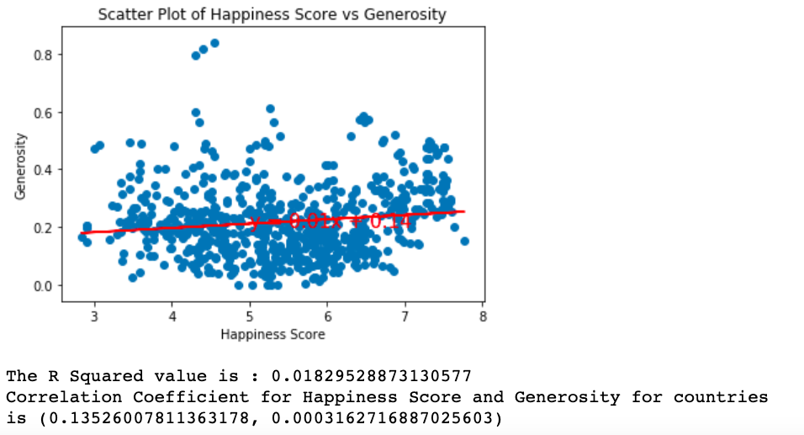
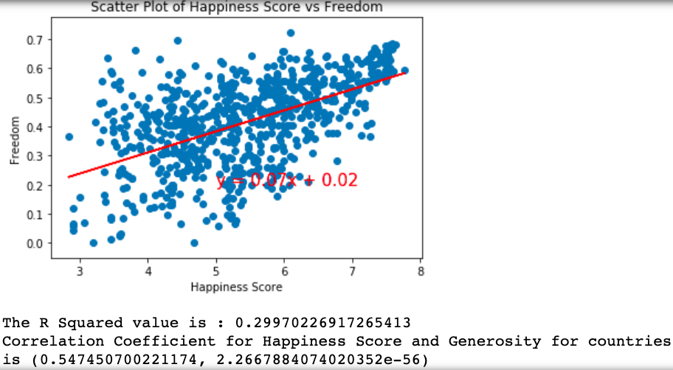
Regression Analysis between Happiness Score and Generosity, Freedom
For the Scatter plot of happiness score vs Freedom the R square value is 0.29. this finding shows a positive associating between Happiness and Freedom. The correlation coefficient was 0.55. Also having a linear line on the scatterplot shows a positive correlation.
For Scatterplot of Happiness Score vs Generosity, the correlation coefficient for happiness is 0.135 showing that it had very little impart on happiness based on our data. The R square value is 0.18 which means there is a positive association between generosity and happiness

Slide 8
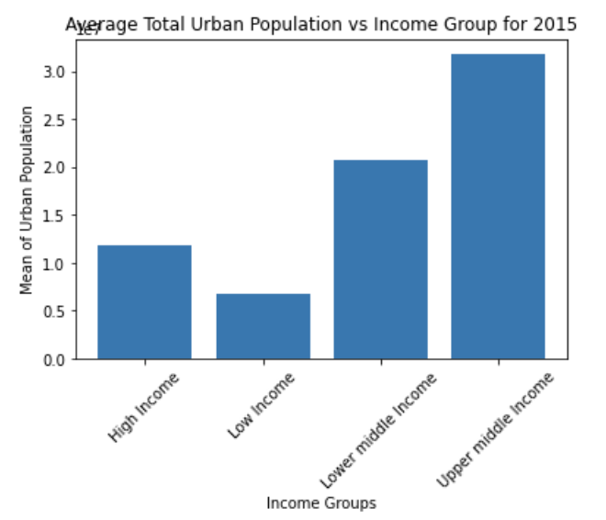

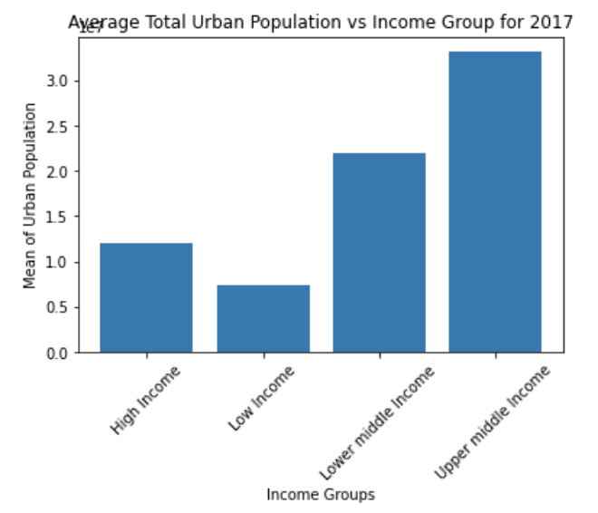
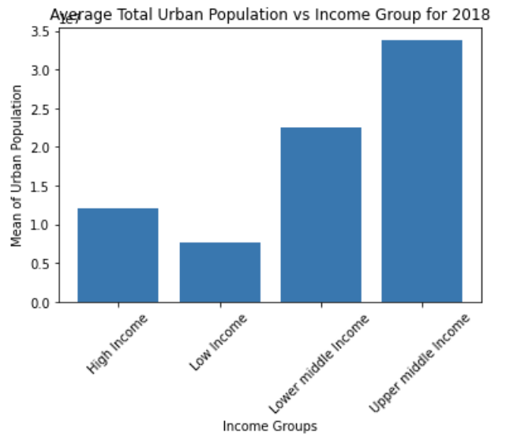
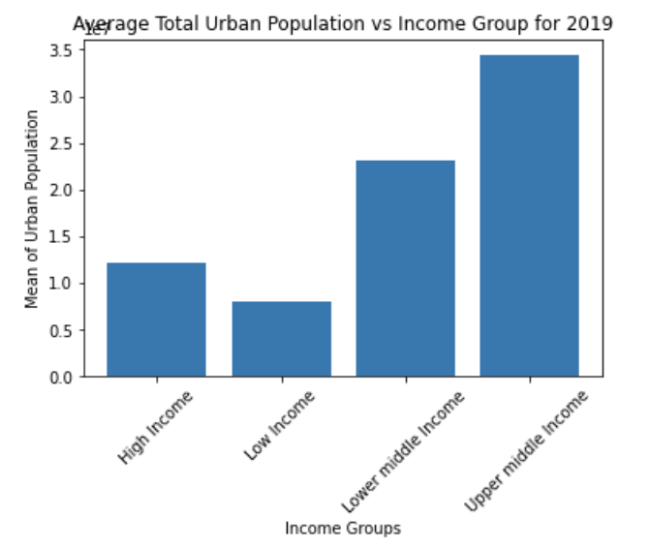
Urban data analysis
-Countries were broken into income groups
-No major changes in urban population size from 2015 - 2019
-Low income countries had the lowest total urban population
-Upper middle income countries had the highest total urban population
-Does size of total urban population have a major impact on happiness score?

Slide 9
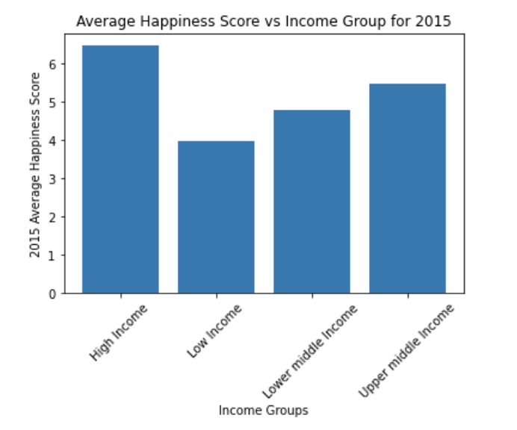
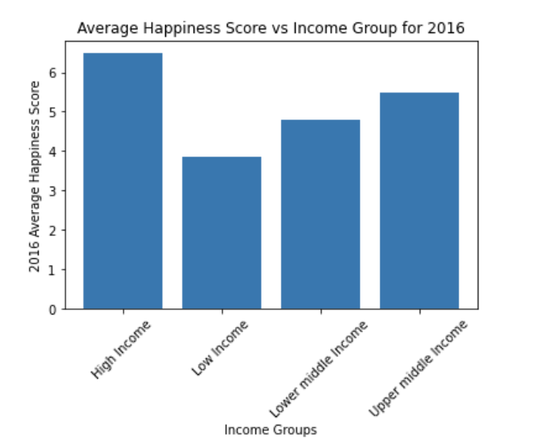
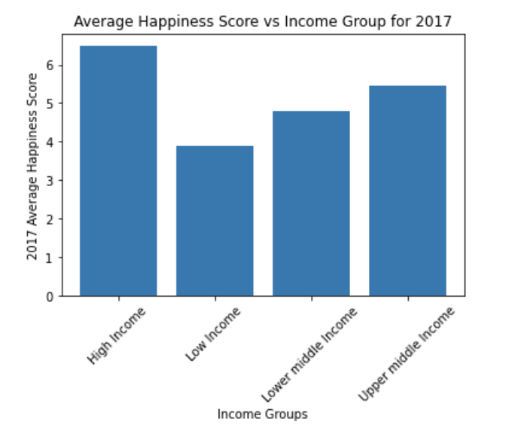
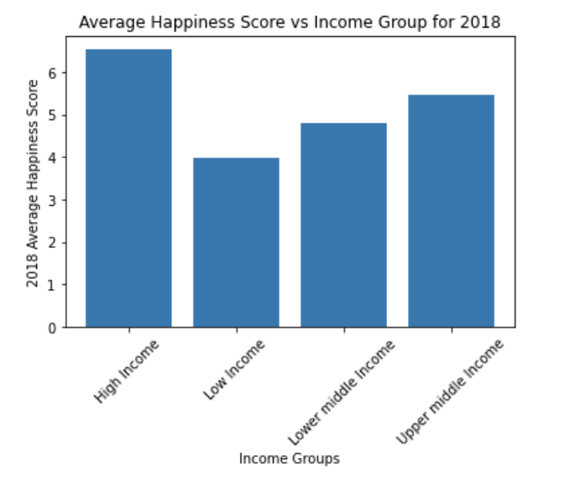
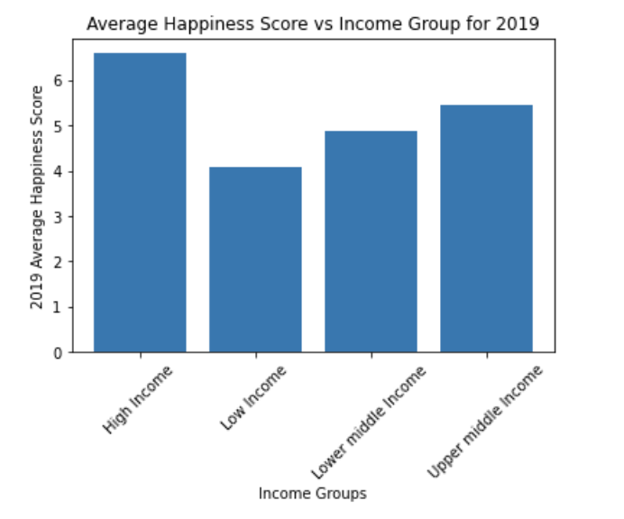
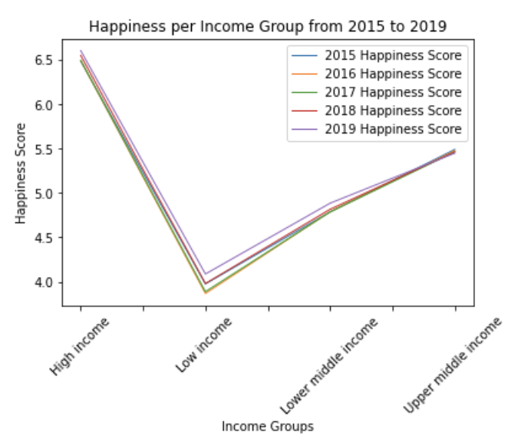
Urban data analysis
-No drastic changes to happiness score across all 5 years for each income group
-High income countries had the highest happiness scores
-Upper middle income countries had the second highest happiness scores
-Is urban population a major factor?
-Higher total urban population may not mean a higher happiness score

Slide 10
Research Driven Questions:
How do natural disasters affect Happiness around the world?
Are happiness scores higher for countries experiencing less natural disasters?
Are happiness scores lower for countries experiencing more natural disasters?
Are there any correlations when focused on:
Number of natural disasters a country experiences?
Number of people affected by natural disasters?
Number of deaths that result from natural disasters?

Slide 11
Interpreting the Data
EM-DAT: The International Disaster Database
Systematic collection and analysis of these data provides invaluable information to governments and agencies in charge of relief and recovery activities.
Natural Disasters included biological, climatological, geophysical, hydrological, and meteorological events.
Timeframe: 2015-2019
Was able to edit the database on the site for the years needed to compare according to the years available with the Kaggle Happiness Data.
Notes:
Biological
Epidemic
Insect Infestation
Climatological
Drought
Wildfire
Geophysical
Earthquake
Mass movement (dry)
Volcanic Activity
Hydrological
Flood
Landslide
Meteorological
Extreme Temperature
Store

Slide 12
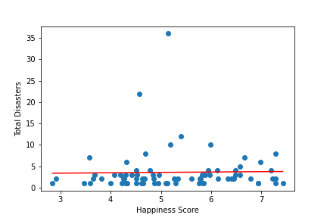
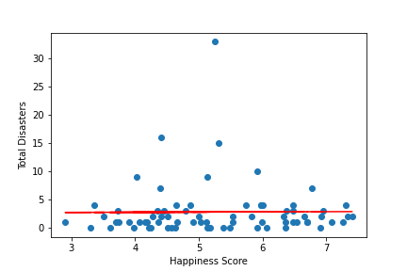
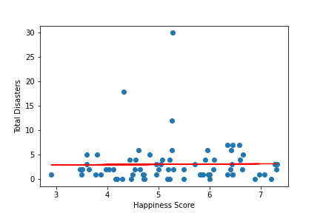
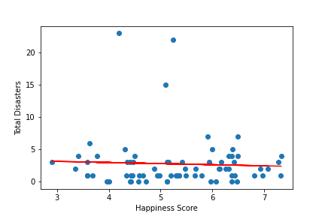
Happiness and Natural Disaster Correlation:
2015
2016
2017
2018

Slide 13
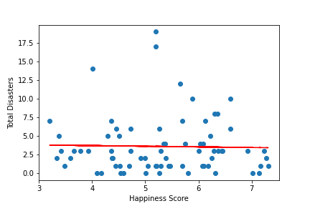
Overall Analysis
2019
Analysis:
At first glance, the linear
relationship between total natural
disasters and a country’s happiness
score is pretty constant(2015-2017).
However, an increase in natural
disasters in 2018 and 2019 indicate
there is a slight negative correlation.
Overall, it does appear that an
increase in natural disasters does
impact the overall happiness score
and rank of a country. More natural
disasters resulted in a higher death
count which has a negative impact
on a country’s overall happiness
levels.

Slide 14
Thank You!!

